Slide 1
AI CAPSTONE PROJECT
AI-Powered Smart Lock System
Combining Facial Recognition and Real-Time Analytics for Optimal Home Security Management
FACE VERIFIED
GUIDED BY
PRESENTED BY
DR. JEENA
MD IMTHIAZ .I(192521360)
S.SAKTHIVEL(192524378)

Slide 2
INTRODUCTION
Smart home security systems are increasingly adopting AI and IoT technologies.
Traditional keys, passwords, and RFID-based systems have limitations such as loss, theft, duplication, and unauthorized sharing.
Facial recognition provides a contactless method for identifying authorized users.
IoT enables communication between the recognition system and the physical lock.
Real-time analytics can monitor access attempts and identify suspicious activities.
This project combines AI facial recognition, hardware-based access control, and a web-based analytics system.

Slide 3
OBJECTIVES
Develop an AI-based facial recognition system for authentication.
Identify authorized and unauthorized users in real time.
1
2
Automate door locking/unlocking using ESP32 and SG90 servo.
Provide alerts for unauthorized access.
3
4
Record access events and timestamps.
Provide a web dashboard for real-time security analytics.
5
6
AI-Powered Smart Lock System
2

Slide 4
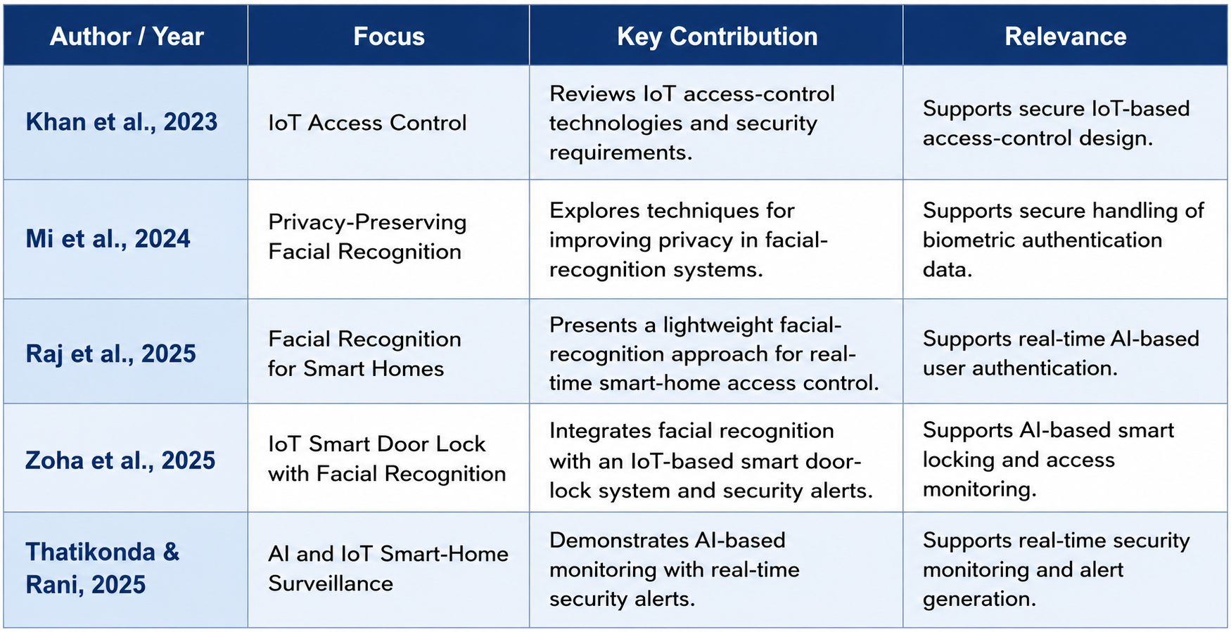
LITERATURE SURVEY
Author / Year
Research Focus
Key Finding
AI-Powered Smart Lock System
3

Slide 5
PROBLEM STATEMENT
!
Traditional locks provide limited intelligent authentication.
!
Keys/passwords can be lost, stolen, shared or misused.
!
Unauthorized access may not be monitored continuously.
!
Existing systems may lack detailed real-time analytics.
!
Homeowners need centralized access history and security monitoring.
!
An integrated AI + IoT + Web solution is required.
AI-Powered Smart Lock System
4

Slide 6
PROPOSED SOLUTION
An AI-integrated smart lock platform is proposed to help users:
SYSTEM WORKFLOW
Authenticate users instantly through facial recognition.
✓
Automatically lock or unlock the door based on the AI decision.
Alert instantly on unauthorized access attempts.
Face Capture
AI Match
Decision
Lock Control
Dashboard
ESP32-CAM
Recognition
Grant/Deny
SG90 Servo
Logged
Log every access event with a precise timestamp.
Notify the admin dashboard in real time.
The workflow begins with a face scan captured by the ESP32-CAM. The AI module matches the face and issues a grant or deny decision, which drives the servo lock and instantly updates the security dashboard.
Display live security analytics for monitoring.
Implementation:
Hardware: ESP32, ESP32-CAM, SG90 Servo
AI: Python + OpenCV (Facial Recognition)
Web: HTML, CSS, JavaScript, Flask, SQLite
AI-Powered Smart Lock System
5

Slide 7
COMPONENTS USED
Component | Purpose
ESP32-CAM | Captures face for facial recognition.
ESP32 DevKit | Main controller and communication.
SG90 Servo Motor | Lock/unlock mechanism.
Buzzer | Unauthorized access alert.
I2C Display | Displays system/access status.
Red LED | Locked / unauthorized indication.
Green LED | Authorized / unlocked indication.
Breadboard | Circuit prototyping.
Jumper Wires | Component connections.
5V Power Supply | Powers the circuit.
Component
Purpose
AI-Powered Smart Lock System
6

Slide 8
SYSTEM ARCHITECTURE
ESP32-CAM
AI Facial Recognition
Authentication Decision
AUTHORIZED
UNAUTHORIZED
ESP32
Access Denied
SG90 Servo → Unlock
Buzzer + Red LED
Green LED + I2C Display
Remains Locked
Database → Web Application → Real-Time Analytics
AI-Powered Smart Lock System
7

Slide 9
MODULES OVERVIEW
Module 1
Module 2
Module 3
AI-Based Facial Recognition
Smart Lock & Access Control
Real-Time Security Analytics & Web App
Face capture
Face detection
Feature extraction
Face matching
Authentication
ESP32
Servo locking / unlocking
I2C Display
LEDs
Buzzer
Access logging
Database
Dashboard
Access history
Security analytics
Unauthorized-attempt monitoring
AI-Powered Smart Lock System
8

Slide 10
MODULE 1: AI-BASED FACIAL RECOGNITION
Purpose
SYSTEM WORKFLOW
To authenticate users in real time by matching a captured face against registered facial data.
Face Capture
To eliminate reliance on physical keys or passwords for entry.
To ensure only verified individuals gain access to the property.
Face Detection
Key Functions
Capture the user's face using the ESP32-CAM.
Feature Extraction
Detect and align the facial region.
Extract unique facial features.
Face Matching
Match features against stored records.
Confirm or reject the authentication request.
Authentication
AI-Powered Smart Lock System
9

Slide 11
MODULE 2: SMART LOCK & ACCESS CONTROL
Purpose
SYSTEM WORKFLOW
To convert the AI's authentication decision into a physical locking or unlocking action.
Access Decision
To provide instant visual and audio feedback on every access attempt.
ESP32 Controller
To maintain a secure, fail-safe locked state by default.
Key Functions
Servo Actuation
Receive the authentication decision from the AI module.
Drive the SG90 servo to lock or unlock the door.
Trigger the Green or Red LED indicator.
LED & Buzzer Signal
Sound the buzzer on denied access.
Update the access status on the I2C display.
I2C Display Update
AI-Powered Smart Lock System
10

Slide 12
MODULE 3: REAL-TIME SECURITY ANALYTICS & WEB APP
Purpose
SYSTEM WORKFLOW
To record every access event and present real-time security analytics.
Access Event
To give homeowners centralized visibility into who accessed the property and when.
Flask Backend
To support quick identification of unauthorized access patterns.
Key Functions
SQLite Database
Log every access attempt with a timestamp.
Store records in the backend database.
Render live dashboard statistics.
Dashboard Rendering
Track unauthorized access attempts.
Display access history and security trends.
Real-Time Analytics
AI-Powered Smart Lock System
11

Slide 13
ADVANTAGES
★
★
★
Enhanced security through facial authentication
Contactless identification
Real-time access decisions
★
★
★
Unauthorized-access alerts
Centralized security analytics
Automatic access history
★
★
★
Web-based monitoring
Low-cost prototype
AI + IoT + Web integration
AI-Powered Smart Lock System
12

Slide 14
FUTURE SCOPE
Multi-factor authentication
Liveness detection
Cloud monitoring
→
→
→
Mobile application
ML-based anomaly detection
Edge AI
→
→
→
Encrypted biometric storage
Smart-home integration
Voice security alerts
→
→
→
AI-Powered Smart Lock System
13

Slide 15
CONCLUSION
✓
Combines AI facial recognition, IoT hardware and web analytics.
✓
Provides automated contactless authentication.
✓
ESP32 + SG90 provide physical access control.
✓
LEDs, buzzer and I2C display provide immediate feedback.
✓
Web dashboard provides real-time monitoring and access history.
✓
Provides a low-cost prototype for intelligent home security.
AI-Powered Smart Lock System
14

Slide 16
REFERENCES
[1] A. Khan et al., “A Comprehensive Systematic Review of Access Control in IoT: Requirements, Technologies, and Evaluation Metrics,” IEEE Access, 2023.
[2] Y. Mi et al., “Privacy-Preserving Facial Recognition Using Trainable Feature Subtraction,” 2024.
[3] A. Raj, M. Marimuthu, and K. Lekshmi, “Smart Home Face Recognition: A Lightweight Approach for Real-Time Access Control,” 2025.
[4] M. S. Zoha et al., “The Development of IoT Based Smart Door Lock and Fire Alert System Using Facial Recognition,” 2025.
[5] S. Thatikonda and S. Sandhya Rani, “Smart Home Surveillance, Monitoring, and Automation with Real-Time Alerts via Raspberry Pi,” 2025.
AI-Powered Smart Lock System
15

Slide 17
THANK YOU
Questions & Answers

